Slide 1
CE101 Team-Project Challenge
Scrum Meeting in Jira-Basics
2018-2019
Vishuu Mohan and Anthony Vickers
with acknowledgements to Dr.Michael Fairbank and Phil Fox (Atlassian)

Slide 2
Agile Team working in CE101
CE101 Labs
Team-based project (Faraday, Bell and Lovelace)
At workplace- many times you have to collaborate with diverse sets of people, some you may not know, some you may not like-Very important skill
Constitutes 50% of your final mark for this course
2

Slide 3
Teams – making a fair contribution
Please turn up to every lab and team meeting
Supervisors will take attendance
Pull your weight and make a fair contribution to the team
Don’t let people down
E.g. by not turning up
E.g. by not doing your assigned tasks
Don’t tolerate free-loaders
Put notes related to absentees/non contributors –JIRA
Scaling factor 0-1 will be applied
There is no Reassessment option for CE101- if you fail the module you have to repeat the year

Slide 4
Team meetings
The Timetabled Lab sessions are the ideal time for weekly scrum meetings
All team members must attend labs
You can have additional Scrum meetings outside lab hours and document it in Jira

Slide 5
Team Meetings (Scrum)
5

Slide 6
Team Meetings (Scrum)
You’ll meet once in two weeks in the timetabled labs
During your meeting decide on what needs to be done and by whom
We will use an Agile development method called “Scrum”
We will use Jira management tool
www.cseejira.essex.ac.uk
6

Slide 7
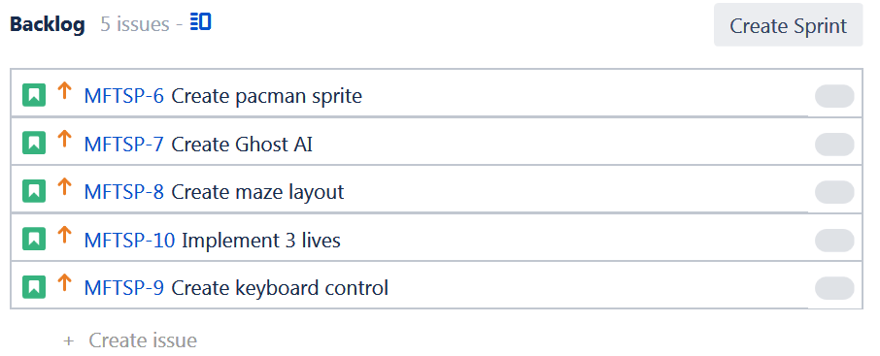
Team Meetings (Scrum)
Your team maintains a global “to do” list, called the “Backlog”
In Jira, click “Create issue” to add a new item
New issue can be classified as a bug, Story, risk, task etc
Choose story
7

Slide 8
Todays Lab- Start your first Sprint
Create Issues/Stories (exploring features in Jira)
Stories are specific to your team project
Prioritize
Estimate complexity
Assign
Start Sprint
From next lab- Sprint retrospective, Other things…

Slide 9
Group Communication
All project-related communication should be stored on Jira
Attach a comment under a Jira issue to communicate
Don’t set up facebook/whatsapp groups etc

Slide 10
Team Meetings (Scrum)
Your team maintains a global “to do” list, called the “Backlog”
Drag issues up and down to re-order the backlog by priority
10

Slide 11
Team Meetings (Scrum)
Your team maintains a global “to do” list, called the “Backlog”
You can assign a story a complexity score – “Story points”
This is an estimate of how long it will take
Initially, assume 1 story point = 1 hour
11

Slide 12
Team Meetings (Scrum)
Your team maintains a global “to do” list, called the “Backlog”
You can assign responsibility of a story to a team member
12

Slide 13
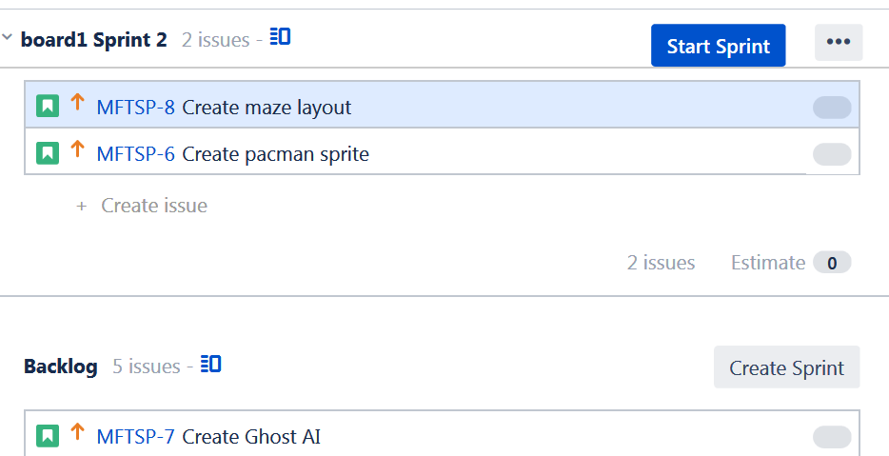
Team Meetings (Scrum)
When you’ve enough items, decide which ones you’re going to do this week (This “sprint”).
Create sprint
Drag those items for this week’s work into the sprint
13

Slide 14
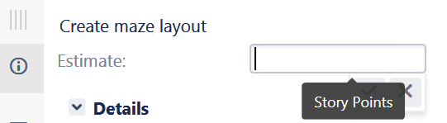
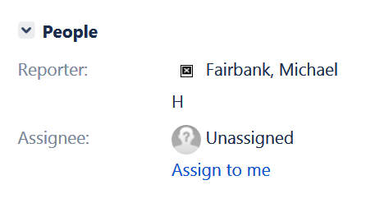
Team Meetings (Scrum)
Check all story points (estimates) are set
Assign tasks to individuals
Click “Start sprint”. Set the sprint duration to 1 week.
Get to work.
14

Slide 15
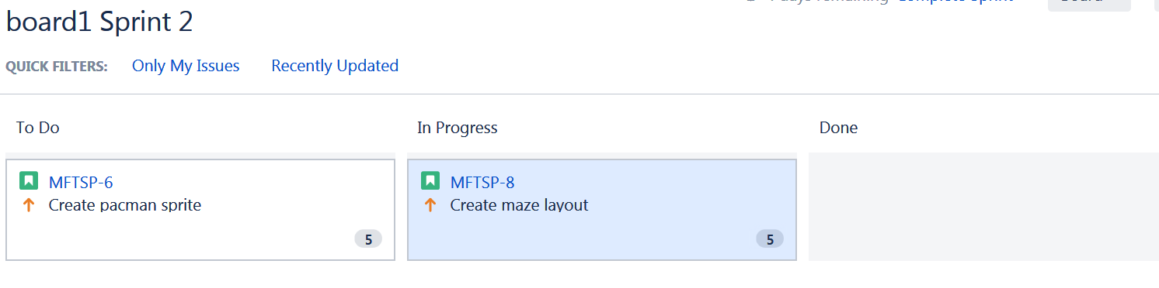
Team Meetings (Scrum)
All team members complete their tasks (stories) over the sprint
As tasks progress, you drag them from left to right
Unassigned tasks can be assigned to people during the sprint
15

Slide 16
Team Meetings (Scrum)
When your task enters Done:
Enter the actual time spent, e.g. 2h
Write a meaningful comment;
And if possible add a link to the git commit / screenshot/ photo of your work, to prove it’s been completed properly
We will look at these during marking
(Also, if your proud of what you’re done, it’s nice to show it off here)
16

Slide 17
Team Meetings (Scrum)
In the following week’s team meeting (every week)
Click “complete sprint”
Reflect on what went well and what didn’t (“sprint retrospective”), e.g. 15 mins:
What did we do well during the sprint?
What could we have done better?
What are we going to do better for next time?
Build and start a new sprint for the coming week
17

Slide 18
Team Meetings (Scrum)
That’s basically what will happen each week in our scrum meetings
Later you will learn more about
stories,
estimating complexity
methods of reporting on your progress with Jira.
For more information now, see https://www.atlassian.com/agile/tutorials/how-to-do-scrum-with-jira-software
18

Slide 19
Team Meetings (Scrum)
Logging in to Jira
Connect to cseejira.essex.ac.uk
Login with your usual Essex id and password
Upload your avatar (profile picture) to be a true photo of yourself
Your project should be there waiting for you, with the correct team members
Navigate to your team’s project under project menu
19

Slide 20
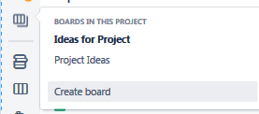
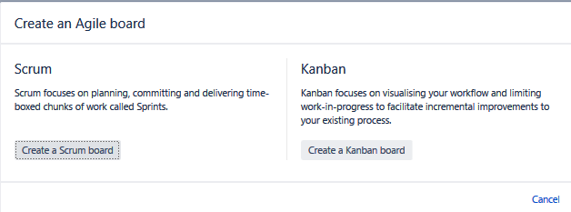
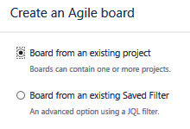
Creating a board on Jira
If you don’t see a “create sprint” button then you’re not viewing a scrum board yet.
Click “Create board”
Then choose scrum board
Choose board from an existing project

Slide 21
Planning Your Work-Tips
Identify “Activities” that will have to be completed
Estimate a time for each of these
Establish pre-requisites
E.g. C can only start when A& B are completed etc.
Establish a critical path
Allocate tasks to team members
21

